Slide 1
Another view of Leadership 360
Charlene Maxey-Harris
University of Nebraska-Lincoln Libraries
October 23, 2012

Slide 2
Leadership
“...is the art of mobilizing others to want to struggle for shared aspirations” (Kouzes & Posner)

Slide 3
ARL fellowship opportunity
Leadership and Career Development Program
Overview
Visits to ARL libraries
Exposure to Big Picture strategic directions
Leadership skills assessment
Mentor program
Supportive colleagues
ARL Strategic Directions
Influencing public policy *Advancing Scholarly communication*Transforming Research Libraries

Slide 4
Elements of leadership: purpose, influence, values, motivation, transformation
What bridge does the organization need to build?
What have built to move the organization?

Slide 5
Leadership is….
Systems based
Everyone’s responsibility
Casting a vision of the future
Bridge impossibilities with reality
Ability to see something and challenge the methods to meet goals
Paint a “vivid description of the future”

Slide 6
Leadership Practice Inventory 360
Model the way
Inspire a shared vision
Challenge the process
Enable others to act
Encourage the heart

Slide 7
Assessment
About relationships
with supervisors, coworkers, direct reports
Self-assessment, self development
Not event, ongoing
Deliberate practice
A aspiration and a choice

Slide 8
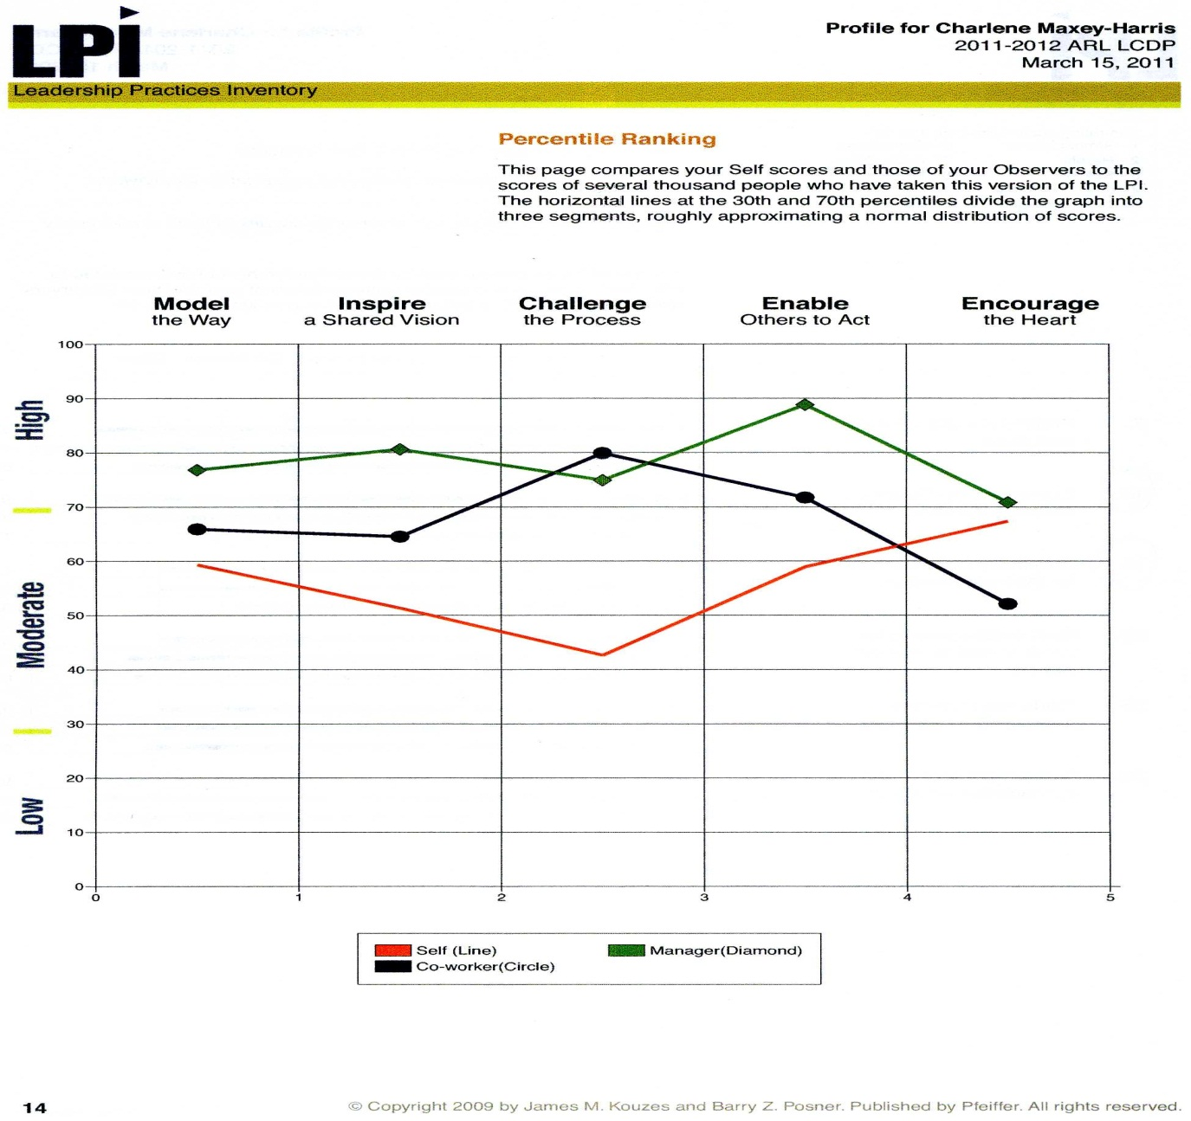
Leadership skills summary

Slide 9
Still developing
Still developing and learning
Time to share vision and goals
Transforming library
Listen, listen, listen
A story….
Thank you for supporting and helping me in my career path!

Slide 10
Leadership Opportunities
Selected list: ACRL/Harvard Leadership Institute http://www.gse.harvard.edu/ppe/programs/higher-education/portfolio/leadership-academic-librarians.html Leadership Lincoln http://www.leadershiplincoln.org/ Nebraska Leadership Institute Senior Fellows Program UCLA Center for Creative Leadership http://www.ccl.org/leadership/index.aspx OCLC WebJunction Leadership Resources http://www.webjunction.org/documents/webjunction/Leadership_Resources.html ALA resources http://www.ala.org/offices/hrdr/abouthrdr/hrdrliaisoncomm/otld/leadershiptraining Frye Leadership Institute, now the Leading Change Institute, http://www.leadingchangeinstitute.org/

