Slide 1
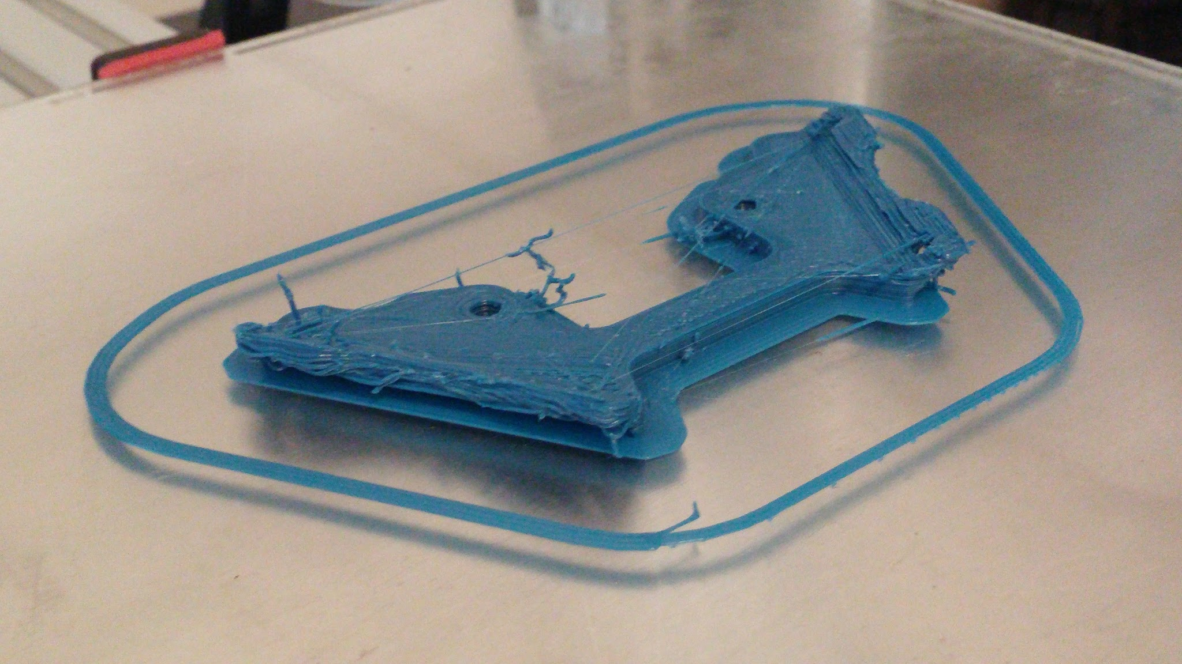
Creative Collaboration with 3D Printing at the Library

Slide 2
Why talk about 3D printing at a library?
The library is about knowledge creation and rapid prototyping represents knowledge creation through action
Just like a printer allows you to turn creative writing into tangible form, 3D printing allows you to produce a tangible model of your idea
Also, consider technology that has become commonplace in libraries: copiers, scanners, computers, laptops, printers…
Library already provides an environment that supports creative thinking and collaboration
Open many hours, to many disciplines...serves as a neutral location on campus that encourages cross-disciplinary collaboration
Having a 3D printer allows experimentation by all students regardless of department
3D printers located in “members only” labs are not broadly useable

Slide 3
So what is it?
Additive manufacturing: the process for making a three dimensional object from a digital file by adding successive layers of material
3D Printing sounds better
Source: reddit user Flux83

Slide 4
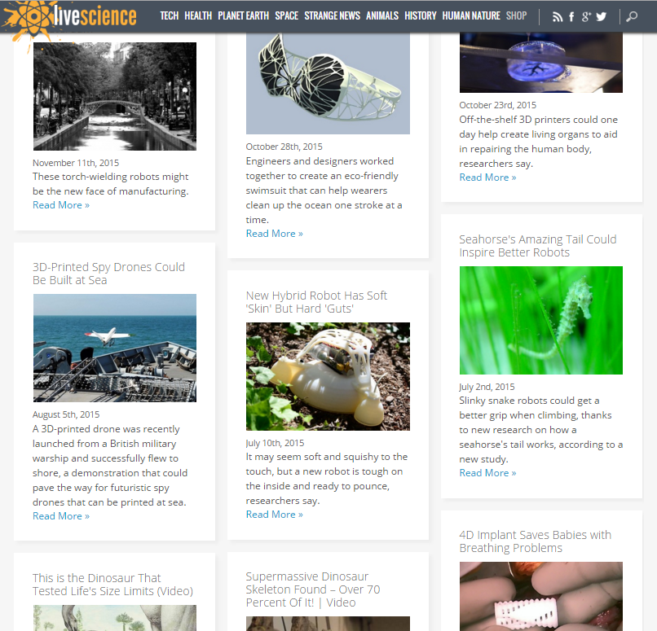
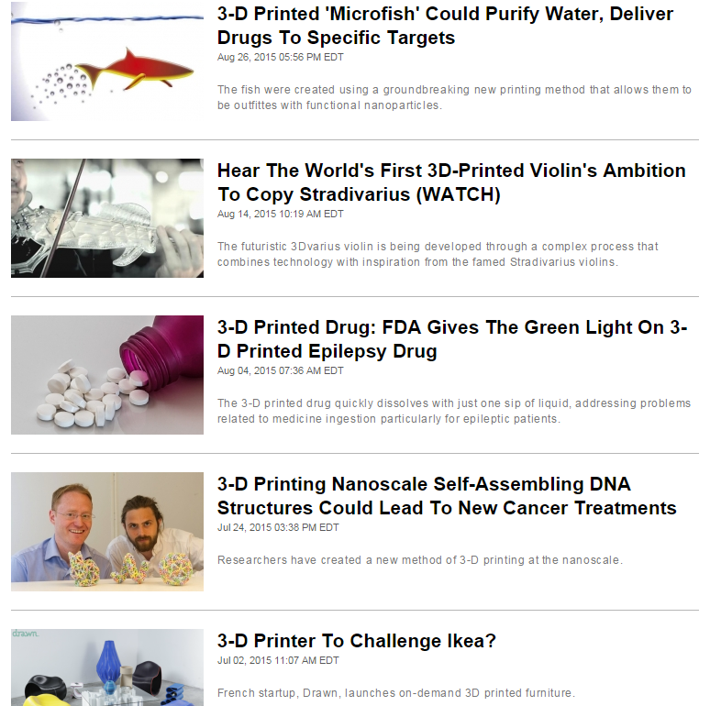
What’s it used for?
Prototyping
Architecture
Medical Industry
Ceramics
Food
Aerospace Industry
Hobbyists
the list continues...
Source: http://www.livescience.com/ & http://endgadget.com

Slide 5
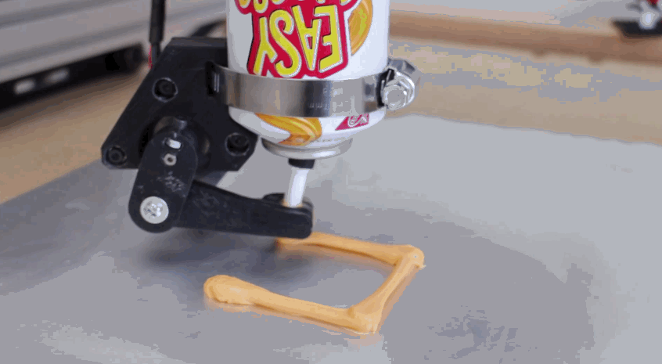
How does it work?
Officially 7 categories
Selective Laser Sintering
Stereolithography
Fused Deposition Modelling
Source: https://www.youtube.com/watch?v=uCy0NEbJf4s

Slide 6
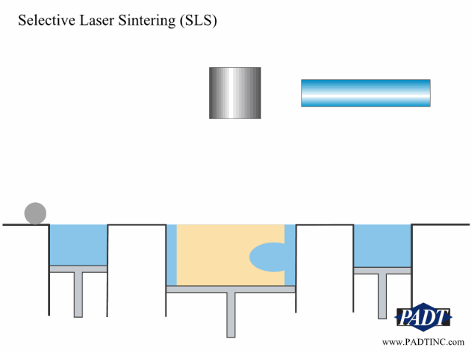
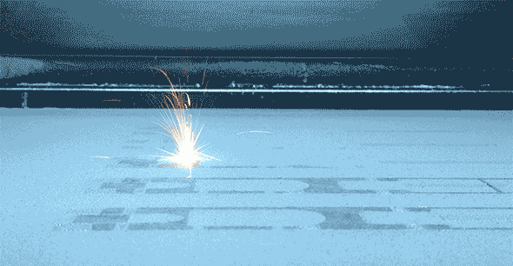
Selective Laser Sintering (SLS)
Lasers are used to cure a powdered material
No support structure needed
Slow process & expensive
Used primarily by manufacturers
Variety of materials: nylon, ceramics, glass, aluminum, steel
Source: https://www.stratasysdirect.com/

Slide 7
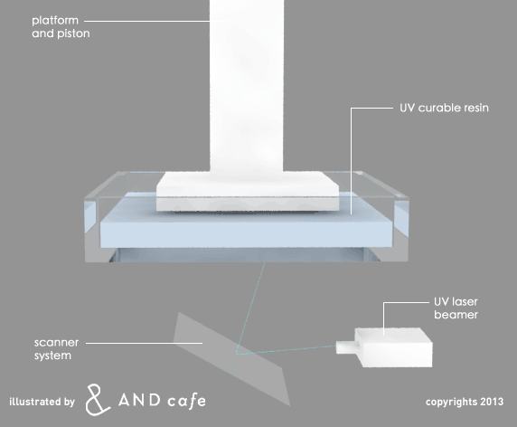
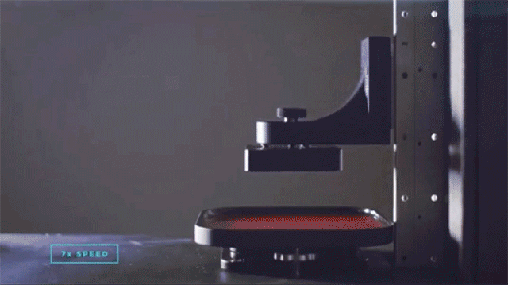
Stereolithography (SLA)
Been around since early 80’s
Useful for small objects and details
Uses a light source to cure liquid resin
Source: http://www.andinc.co/what-is-stereolithography/
Source: http://carbon3d.com

Slide 8
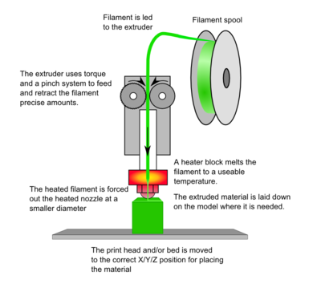
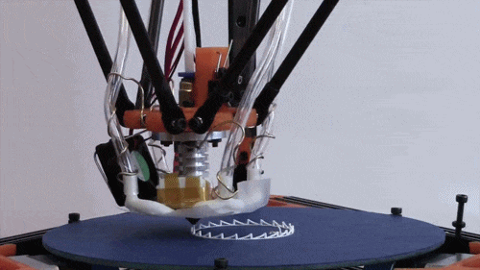
Fused Deposition Modelling (FDM/FFF)
Can use high performance and engineering grade thermoplastics
Builds an object layer by layer by heating and extruding thermoplastic filament
Majority of hobbyist & local printers
Source: http://www.andinc.co/what-is-stereolithography/
Source: http://3dprinttheworld.com

Slide 9
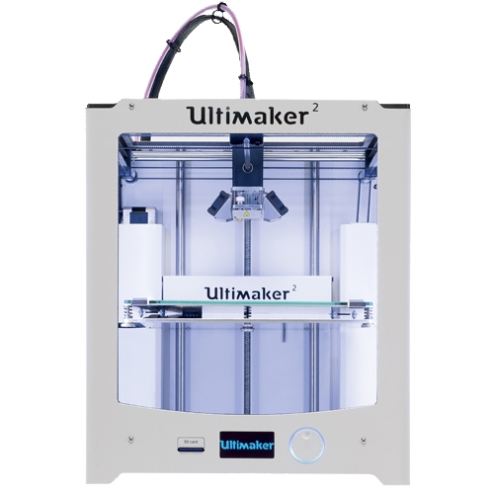
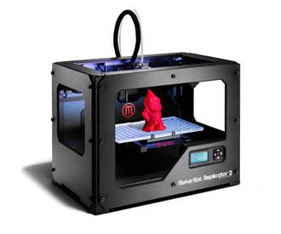
What does UNL offer?
Print Services:
1700 Y st.
Makerbot Replicator 2 ~$2500
11”x6”x6” build size
Print cost $0.21/gram
Open to anyone in UNL community and the public
Architecture Fabrication Lab:
ARCH 210
Six printers
Print cost ??
Anyone in College of Architecture
Others can use but low priority
Art Fabrication Space:
Richards Hall 28A
Relatively new lab & equipment
Print cost ??
Art students only
EE Lab:
SEC 122
Ultimaker 2 ~$1999
8.7”x8.7”x8.7”
Print cost $1/print + $0.05/gram
EE students only

Slide 10
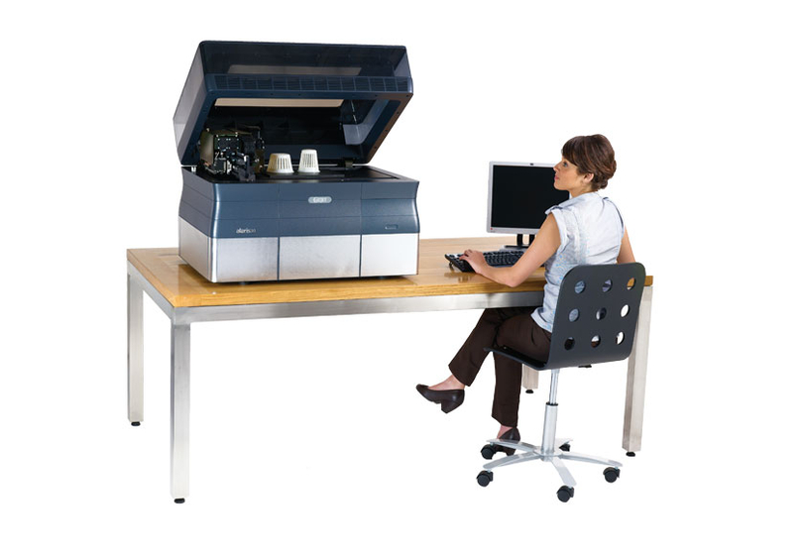
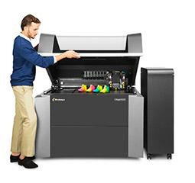
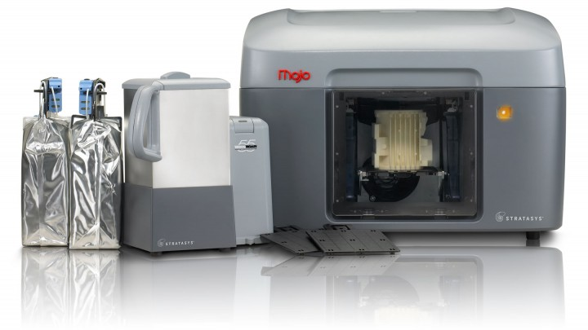
What does UNL offer?
Innovation Studio:
Innovation Campus
2x Ultimaker 2’s ~$1999
16”x14’x16” build size
0.02 mm resolution
Stratasys Mojo ~$7000
5”x5”x5” build size
0.178 mm
ABS & soluble support material
Requires membership $60-140/semester for UNL affiliates and $55/month public
Scott Engineering Center:
SEC 307, 313.1, 360
Makerbot Replicator 2
Objet30 Pro ~$40,000
polyjet
11.8”x7.9”x5.9”
0.016 mm resolution
$0.55/gram
EE students only
Nanoscience Research Center:
NANO N213
Objet500 Connex3
~$330,000
polyjet
19.3”x15.4”x7.9”
0.016 mm resolution
$0.13/gram support + $0.36/gram
EE students only

Slide 11
What is it used for on campus?
Architecture: models, parts, scale furniture, curved walls and shapes, beam designs
Textiles: an entire class does group & individual projects requiring them to design an object then 3D print it
Archaeology: 3D scans and reproductions of artifacts, bones, dig sites
Chemistry: complex chemical models to aid in visualization
Anatomy: bone reproductions and scans for teaching aids
Film studies: looking to design and make props, animation helpers
UNL Maker Club
Electronics enclosures
Drone & Robotic parts

Slide 12
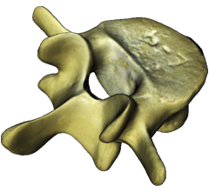
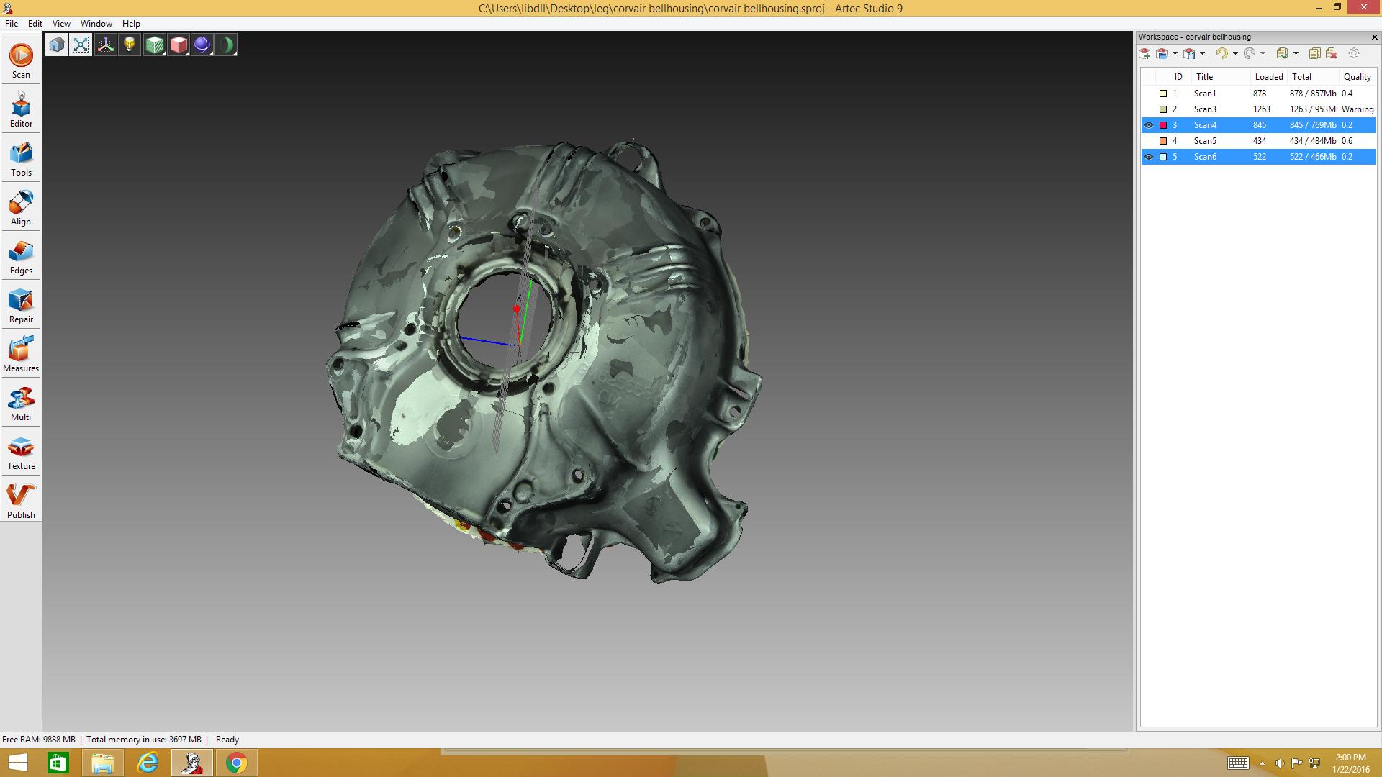
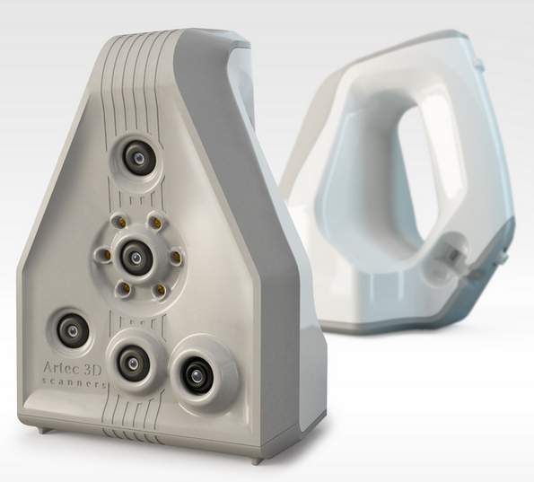
Where do we fit in?
Artec Handheld 3D Scanners
takes accurate detail and texture scans
0.5 and 0.1 mm accuracy
powerful software
steep learning curve
$35,200
3D Modelling Software
Rhinoceros 5
Blender (Free)
Autodesk Inventory
AutoCad
3DS Max

Slide 13
What’s available outside the University?
Wesleyan University Art Department: http://wits.itech.nebrwesleyan.edu/?cat=11
Local area public schools including Beatrice, Omaha and Lincoln
UNO Criss Library: http://libguides.unomaha.edu/c.php?g=100525&p=649717
UNMC McGoogan Library: http://unmc.libguides.com/content.php?pid=653308&sid=5410699
Creighton Reinert Alumni Library: http://www.creighton.edu/fileadmin/user/reinert/docs/circulation/RAL_3D_Print_Flier.pdf
Do Space (Omaha): http://dospace.org (open access technology library)
Omaha Metro Community College Fab Lab: http://fablab.mccinfo.net/
Makeshift Lincoln: http://makeshiftlincoln.org/ (local public makerspace)
3D Hubs: https://www.3dhubs.com/ (upload a print for someone local to make for you)

Slide 14
Some questions & discussions heard:
Q: What is PLA made of? A: It’s a corn-based biodegradable plastic
ABS allows for stronger parts but harder to print with, can also be smoothed/dissolved with acetone
One of the reasons for 3D printing companies using their own filaments (aside from profits) is predictable tolerances, taking the guesswork and measurements out of every filament change
Some machines can do two or more materials allowing for dissolvable support material like PVA or HIPS
Some printers use open-source software others use proprietary. Some commercial options available (Simplify3D)
Other materials that printers, like the ones showed, can print: wood, carbon fiber, nylon, rubber, PETg
Thingiverse.com & yeggi.com are just a couple of many sites where you can search/download free 3D models
3D models often have to be designed with 3D printing in mind such as orientation, thickness, overhangs
Q: What about toxic fumes? A: There aren’t very many studies done yet with regards to 3D printers in the home/school/office. So far it’s somewhat agreed that PLA (what most of the UNL printers use) poses the fewest risks compared to ABS which would generally require ventilation if used in a smaller closed space
Q: Why do we have the 3D printer and not use it? A: No space for it?

Slide 15
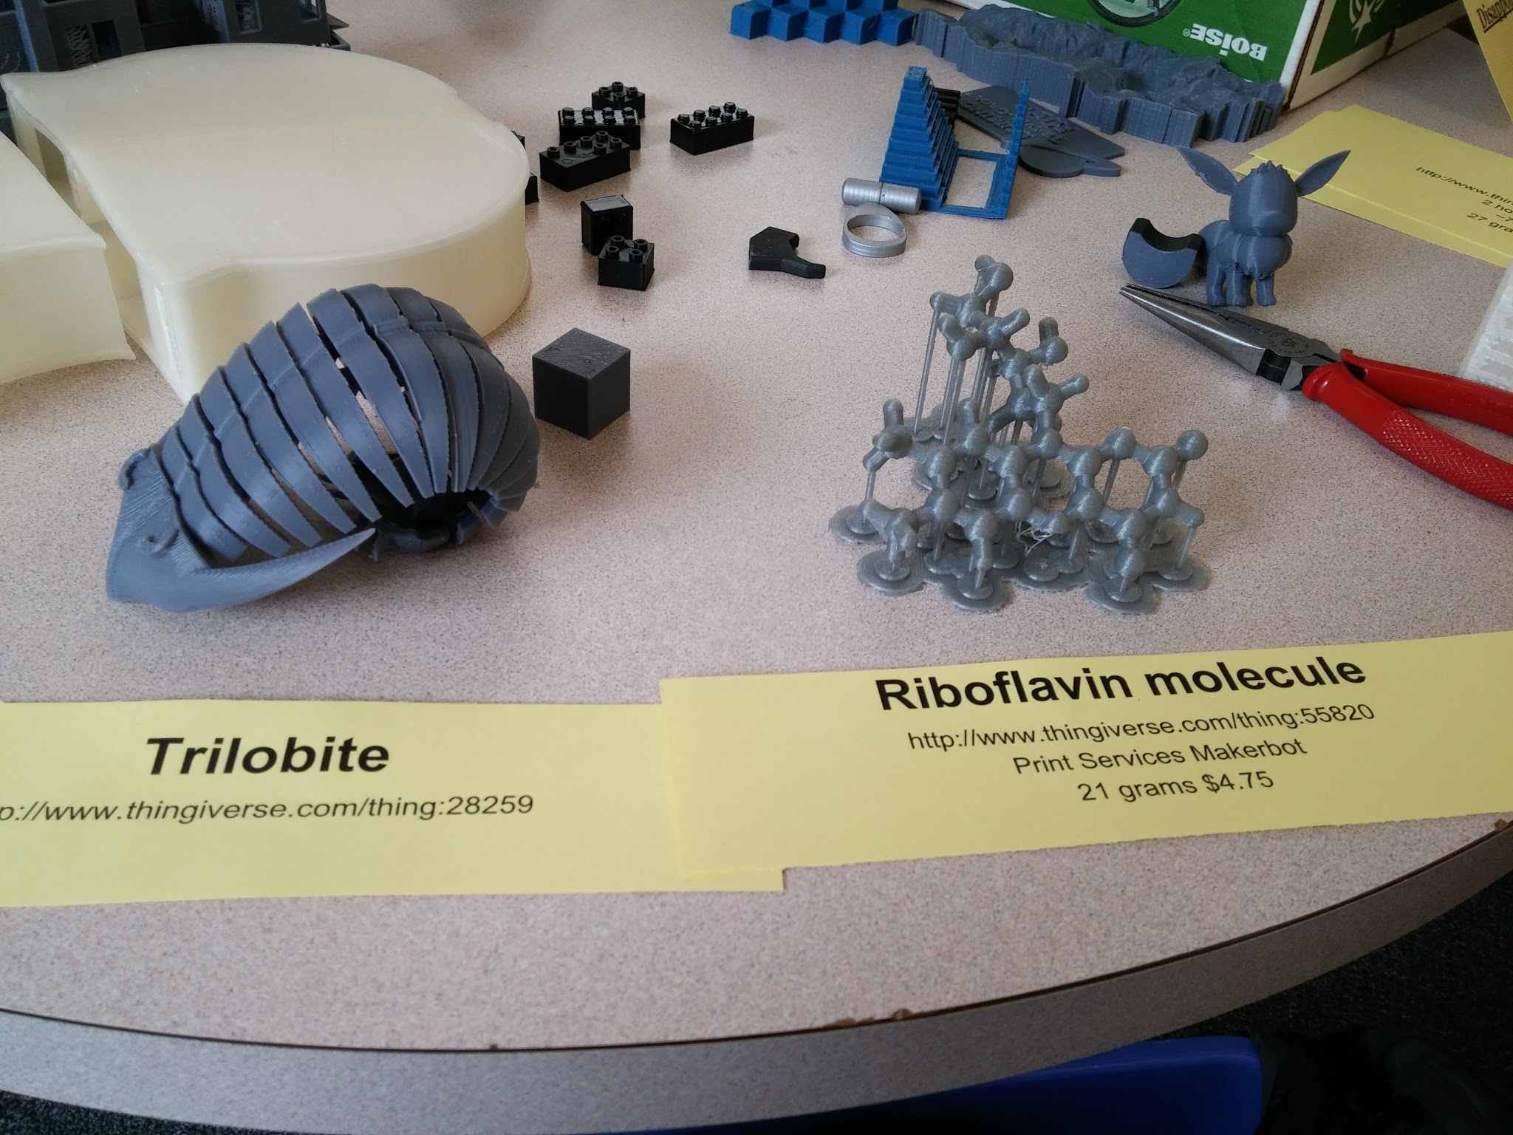
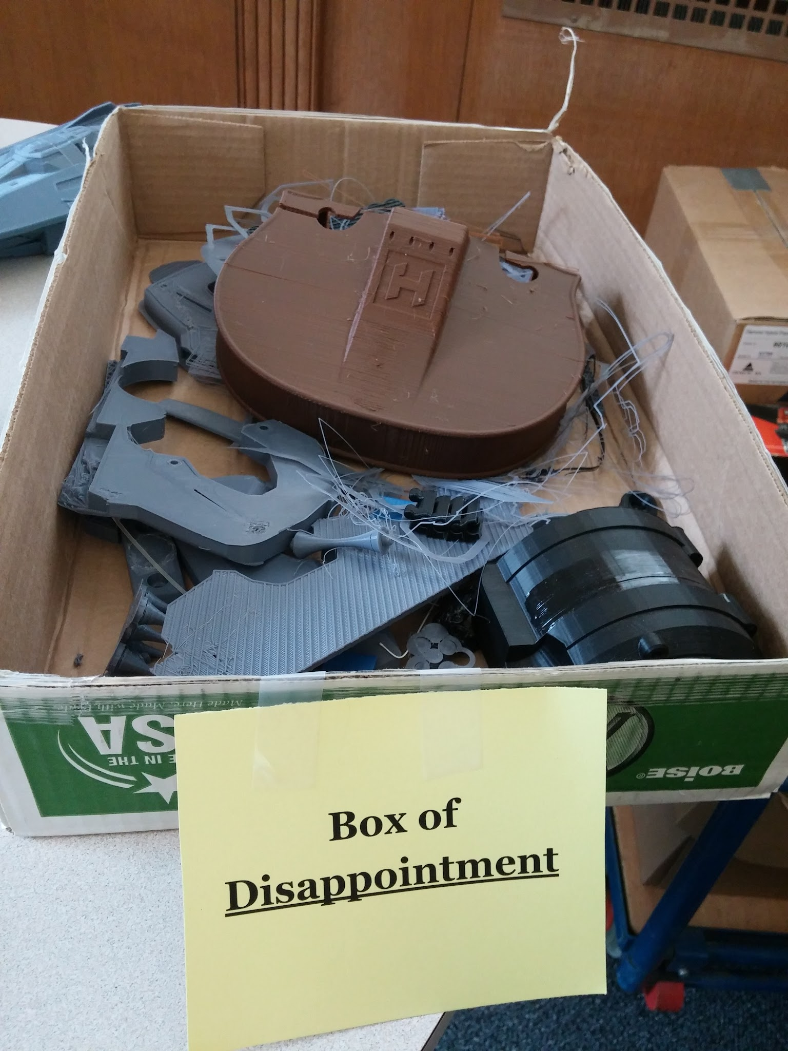
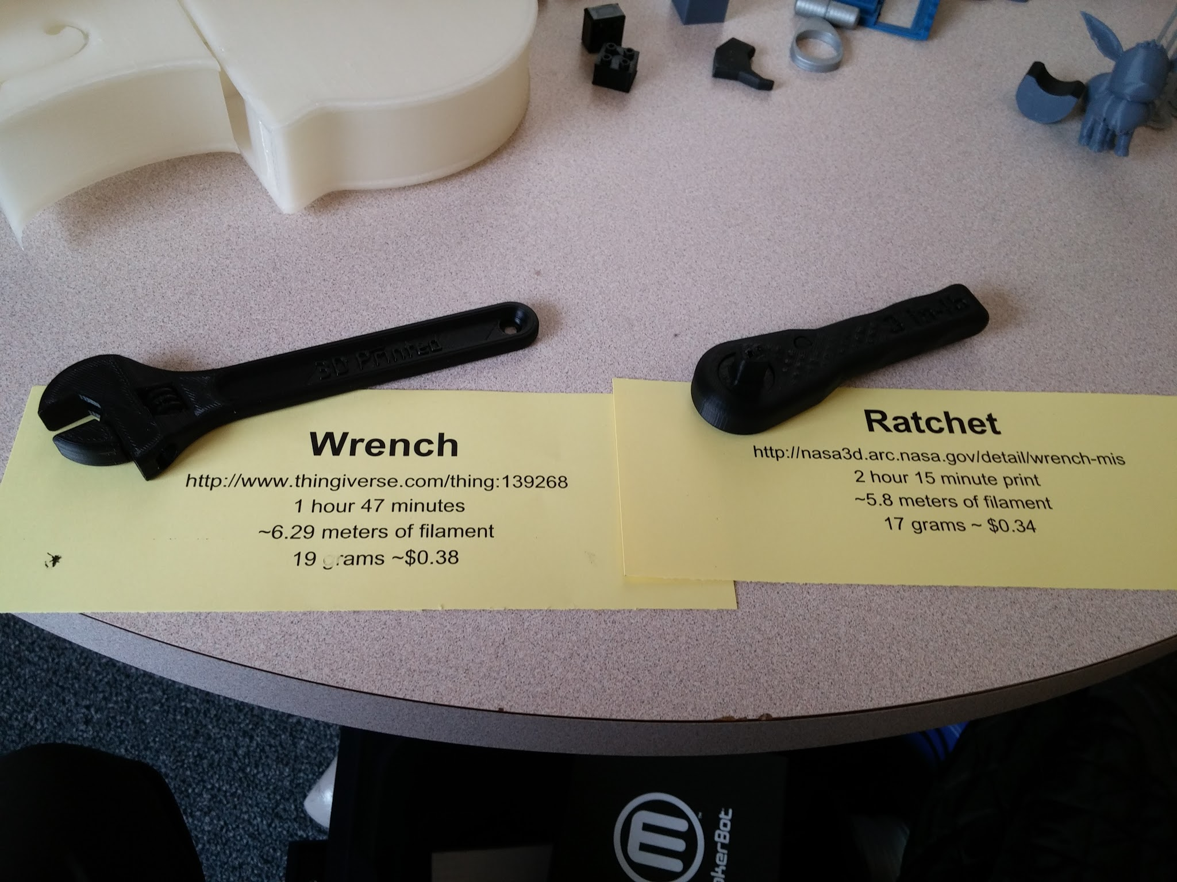
Example Prints

Slide 16
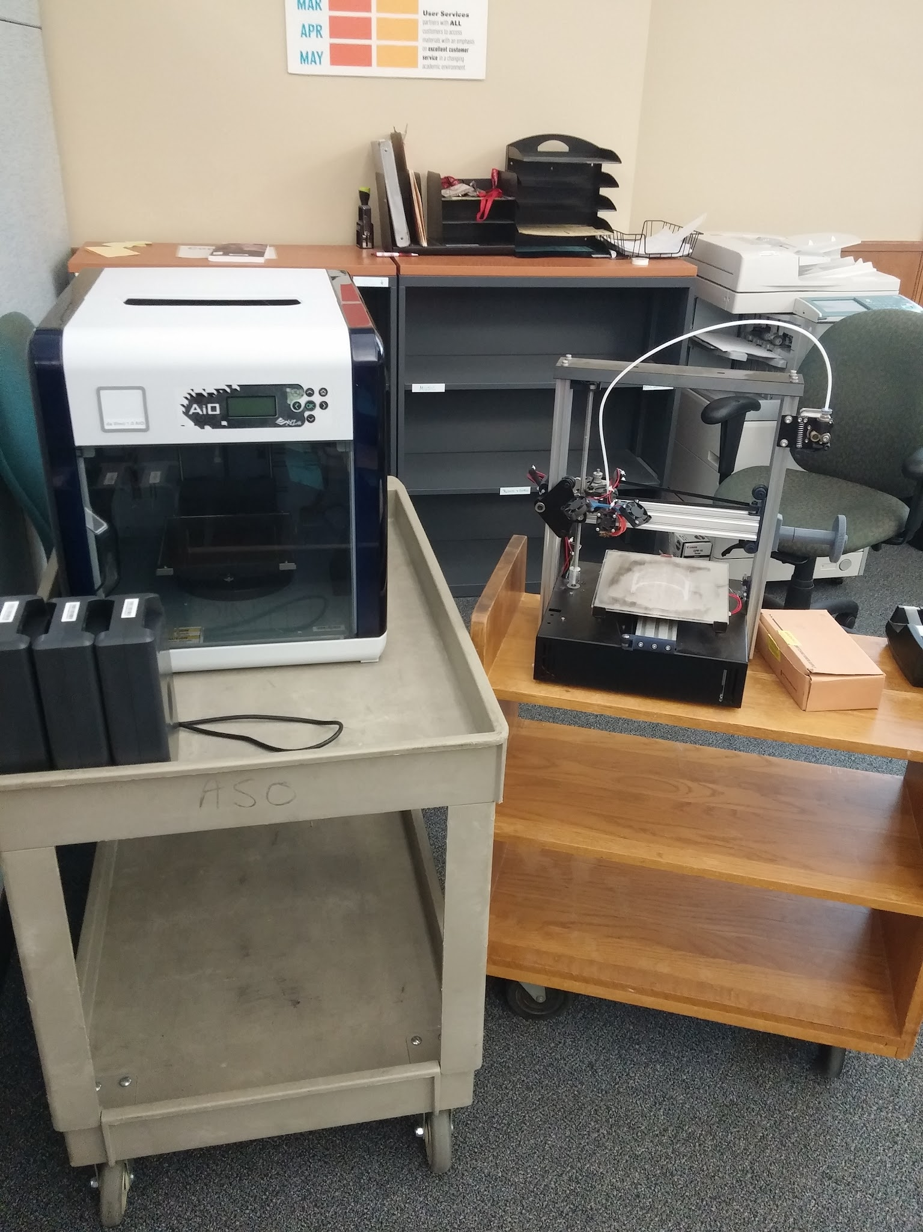
The two printers displayed
CORS: DaVinci AiO
-7.8”x7.8”x7.5” build area
-Resolution: 0.1mm - 0.4mm
-PLA & ABS filaments
-Built-in 3D scanner
-0.25 mm accuracy
-XYZ Software
-Price $799
-Filament cost: $28/600 grams
Robert’s: Fusematic3D
-7.8”x8.5”x7.8” build area
-Resolution: 0.1mm - 0.4mm
-PLA, ABS, Wood, Nylon, PET+, Carbon fiber
-open-source
-Price $799
-Filament cost: $15/1000 grams (PLA/ABS)

Slide 17
References & Links:
Outdated UNL printer list: http://www.unl.edu/trl/3d-printers-university-nebraska-lincoln
Articles on 3D printer particle emissions: http://pubs.acs.org/doi/full/10.1021/acs.est.5b04983 & http://www.sciencedirect.com/science/article/pii/S1352231013005086
3D Printing Fumes: http://hackaday.com/2016/02/01/3d-printing-fumes-new-science/
3D printing at Hendrix: http://www.slideshare.net/davidjhinson/creative-collaboration-at-hendrix-3d-printing-maker-spaces
Intro to 3D printing technology: http://3dprintingfromscratch.com/common/types-of-3d-printers-or-3d-printing-technologies-overview/ & http://3dprintingforbeginners.com/3d-printing-technology/
3D printers in academic libraries:
http://acrl.ala.org/techconnect/post/3d-printers-in-the-library-toward-a-fablab-in-the-academic-library
http://www.istl.org/14-fall/refereed3.html
http://www.tandfonline.com/doi/abs/10.1080/01930826.2014.893110?af=R&
http://er.educause.edu/articles/2014/10/making-it-real-3d-printing-as-a-library-service

Slide 18
Information about UNL labs
Print Services UNL 1700 Y st
Contact: Scott Hawco (Bindery Supervisor) 402-472-7804 shawco2@unl.edu
News: http://news.unl.edu/newsrooms/unltoday/article/print-services-offers-new-3-d-option/
http://news.unl.edu/newsrooms/unltoday/article/student-helps-launch-3-d-printing-program/
Website:
Equipment: Makerbot Replicator 2 (~$2500) FFF
Type: FFF
Build Size: 11”x6”x6”
Resolution: 0.1 mm
Materials available: PLA ($40/roll)
Cost: $0.21*(Weight of Model +Weight of Support Material in grams)
Who has access: Anyone in UNL community, public have access (not advertised & lower priority), pay for material only
Primary users: Used by the textiles design class which requires the students to design and print an object.
Comments: Not used as often as they’d like.
Architecture Fabrication Lab 210 Arch Hall
Contact: Peter O’Brien (Media Center Manager) pobrien9@unl.edu
Website: http://architecture.unl.edu/degree-programs/facilities/fabrication-lab
Equipment: Six printers (no specifics)
Cost: ??
Who has access: Authorized personnel only.
Primary users: “Everyone” in college of architecture. Most often used in student assignments for things like model staircases, roofs, animals, furniture.
Comments: They’ve had folks from other departments and campuses use the equipment. Public use is allowed though not advertised. Priority is given to students and the print queues can sometimes be days long.

Slide 19
Art Fabrication Space Richards Hall 28A
Contact: Matt Bukrey (Art Fabrication Space Manager) bukrey@unl.edu
Website: http://arts.unl.edu/art/facility/art-fabrication-space
Equipment: Not shared
Cost: ??
Who has access: Art and Art History enrolled students, staff, and faculty only.
Primary users: Art and Art history students for both curricular and independent projects
Comments: The technology is still new, they’re hoping to get more use from the students soon.
Scott Engineering Center SEC 360, SEC 313.1, SEC 307
Contacts: Dr. Jeffrey Shield Mechanical & Materials Engineering Professor/Chair jshield@unl.edu
Website: http://www.unl.edu/trl/3d-printers-university-nebraska-lincoln
Equipment: Objet30 Pro (~$40,000)
Type: Polyjet
Build Size: 11.8”x7.9”x5.9”
Resolution: 0.016
Materials: Rigid Vero multiple colors
Cost: $0.55(gram support + gram model)
Equipment: Makerbot Replicator 2 (~$2500) FFF
Type: FFF
Build Size: 11”x6”x6”
Resolution: 0.1 mm
Materials available: ABS ($40/roll)
Who has access: Engineering Students

Slide 20
Voelte-Keegan Nanoscience Research Center NANO N213
Contacts: ?? outdated
Website: http://www.unl.edu/trl/3d-printers-university-nebraska-lincoln
Equipment: Objet500 Connex3 ($330,000)
Type: Polyjet
Build Size: 19.3”x15.4”x7.9”
Resolution: 0.016
Materials: Rigid Vero multiple colors
Cost: ($0.13/gram support + $0.36/gram model)
Who has access: ??
Electronics Engineering Center 122 SEC
Contact: Paul Marxhausen (EE Shop Manager) pmarxhausen@unl.edu
Website: http://eeshop.unl.edu/3d_printing.html
Equipment: Ultimaker 2 (~$1999)
Type: FDM
Build Size: 8.7”x8.7”x8.7”
Resolution: 0.02 mm
Materials available: PLA, ABS, HIPS, T-Glass, Nylon
Cost: $1/print + materials (approx. $0.05/gram)
Who has access: Electronics Engineering students only
Comments: High demand

Slide 21
Innovation Studio @ Innovation Campus
Contact: Liana Owad (NIS Coordinator) lowad2@unl.edu
Website: http://innovationstudio.unl.edu/machines
Equipment: 2x Ultimaker 2 (~$1999)
Type: FDM
Build Size: 16”x14”x16”
Resolution: 0.02 mm
Materials available: PLA ($40/roll)
Cost: ??
Equipment: Stratasys Mojo (~$7000)
Type: FDM
Build Size: 5”x5”x5”
Resolution: 0.178 mm
Materials available: ABSplus, SR-30 support material ($400/cartridge)
Cost: ??
Who has access: UNL Maker Club, Members only ($60-140/semester UNL affiliates, $55/month community)

